Slide 1

Set 1

Slide 2

Go over the set 1 initial sounds - stretchy, then bouncy.

Slide 3
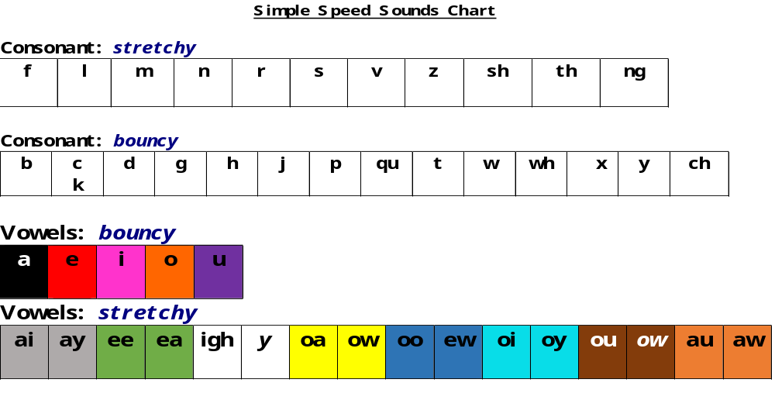
Go over the sounds on the chart.

Slide 4

Sound Blending book 1
Click on the link and read the words in the book each day.
Talk about what the words mean and put the words in sentences orally.

Slide 5

Practise reading then spelling these words from the Sound Blending book throughout the week-
dad
pit
sad
dip
pat
dog
dot
sit
pop
tin
pip

Slide 6


Slide 7
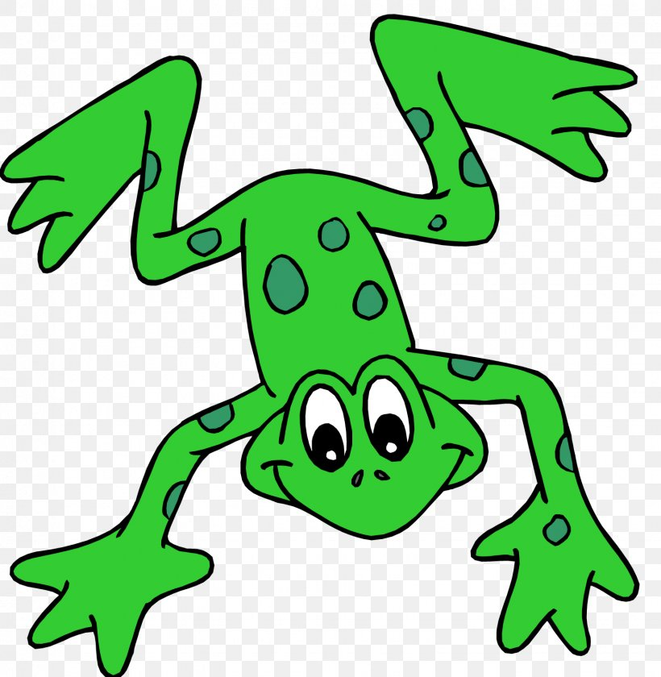
Hold a sentence – adult says the sentence; you say the sentence; my turn/your turn; then you write the sentence remembering a capital letter at the start and full stop at the end. Hide the sentences before you try to write them. One sentence each day.
Dad is in the sand pit.
He pats the dog.
Sit on the mat.
She can pop it.

Slide 8

Play the
Castle game -

