Slide 1

P4 SfL Learning objectives
Week 2
i_e
* Read the speed sound chart on the next page

Slide 2

*Say and point to the sounds i-e

Slide 3

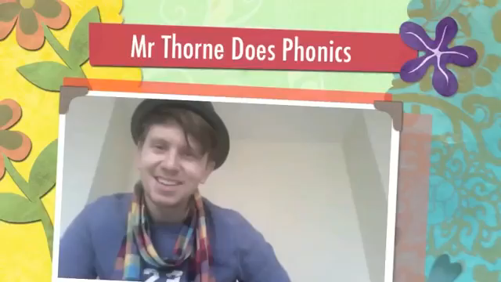
Try to read these flashcards

Slide 4
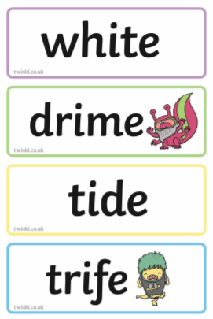
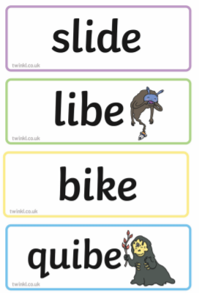
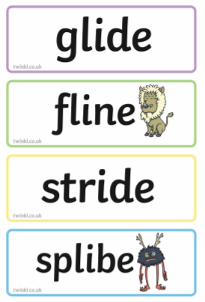
How quickly can you read these words. Time yourself. (watch out for the alien words!)

Slide 5
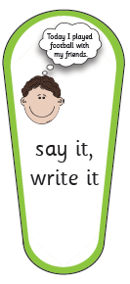
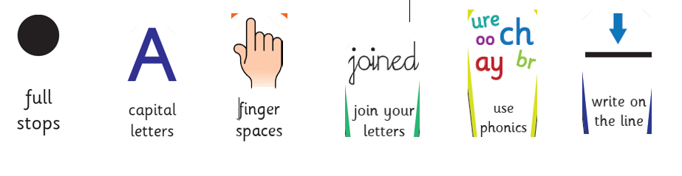
Dictation:
*listen to the sentence 1
*listen to sentence 2
Say it/ write it
Remember, to get 7 points you need

Slide 6

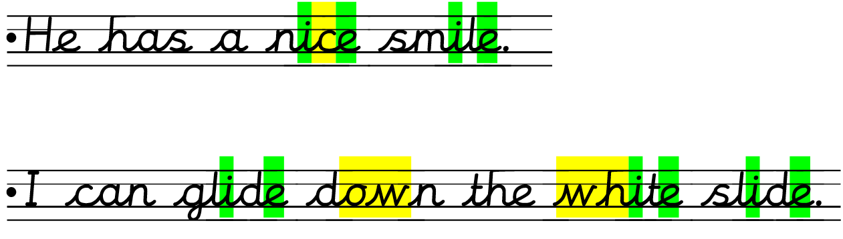
Did you get all your points?
*Give yourself a superstar!
Tricky bits! I-E sound

Slide 7

Now have a listen to this poem

Slide 8
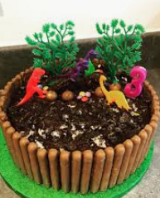
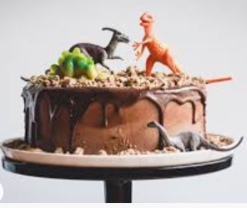
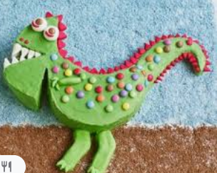
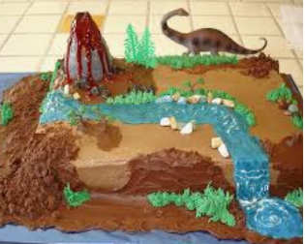
Extra activities:
Can you spot the rhyming words?
In the poem, which word rhymes with:
Bake-
Eyes-
Think-
Maybe you could design your own dinosaur cake. What would you use to decorate it with?

Slide 9
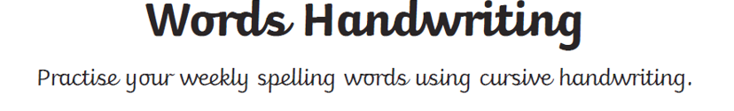
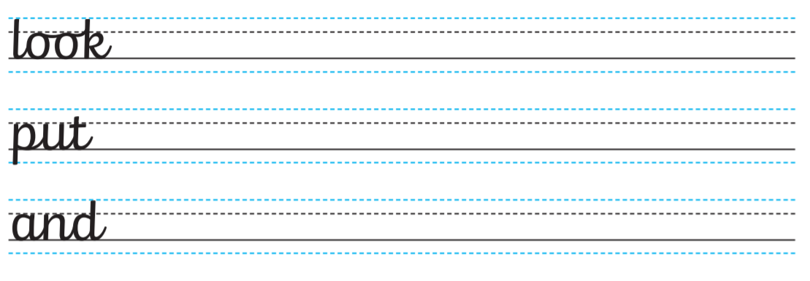
*Open your jotter on a lined page.
*Copy each word 3 times in cursive script.
Make sure you remember finger spaces and sit all your words on the line.

Slide 10
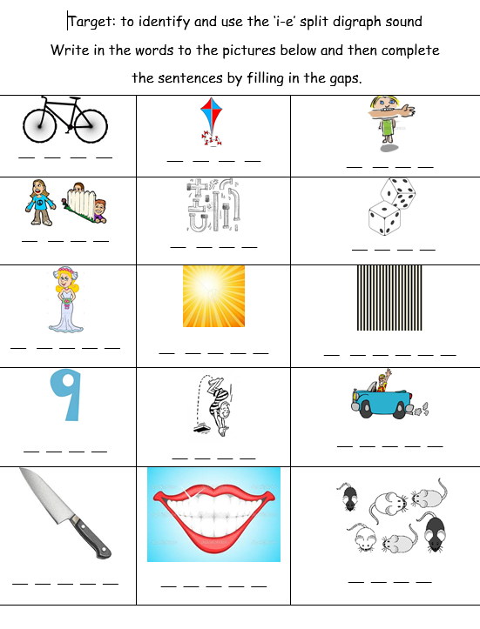

Write these words in cursive script in your jotter. Draw a picture next to each word

Slide 11
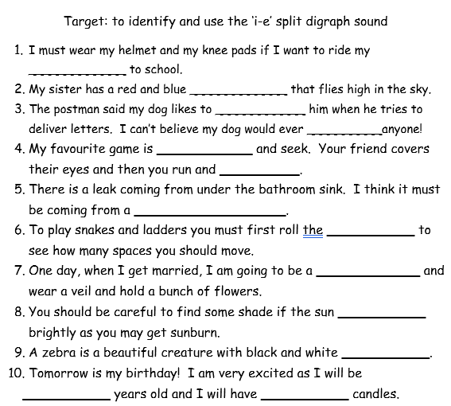

Slide 12

*Open your jotter. Copy out the words filling in the missing letters.
* Write a sentence for each word.

Slide 13
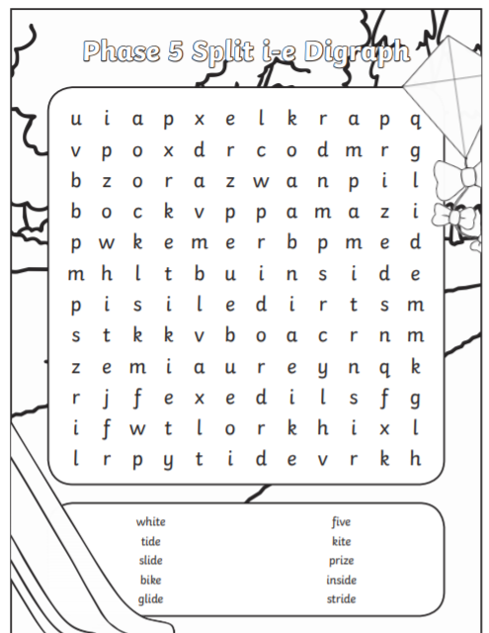
Find the words in the word search.
You do not need to print this sheet.

Slide 14

*Now have a go at reading this book.
Reading book- Alien Adventure

Slide 15

Well done!

